Slide 1
4
Long-Term Financial Planning and Growth

Slide 2

Chapter 04– Index of Sample Problems
Slide # 02 - 05 Plowback and dividend payout ratios
Slide # 06 - 08 Constant growth planning
Slide # 09 - 13 Percentage of sales planning
Slide # 14 - 16 External financing need
Slide # 17 - 23 Pro forma with external financing
Slide # 24 - 27 Capacity level
Slide # 28 - 29 Internal growth
Slide # 30 - 34 Sustainable growth

Slide 3
2: Plowback and dividend payout ratios
Your company has net income of $1,600 for the year. You paid out $400 in dividends to your stockholders.
What is the dividend payout ratio?
What is the plowback ratio?
What is the dollar increase in retained earnings?

Slide 4
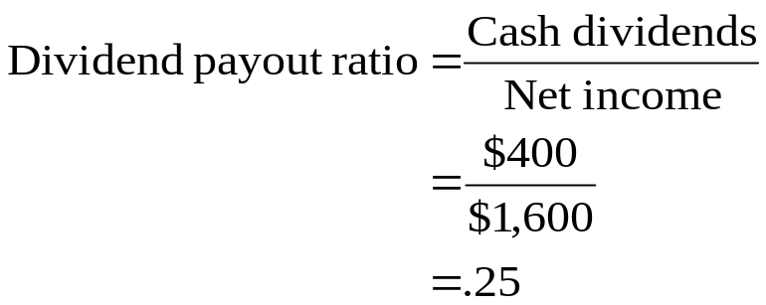

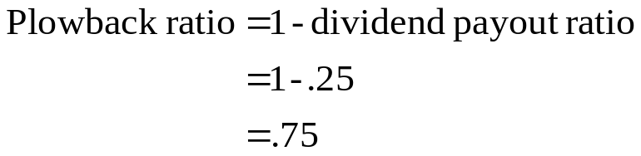
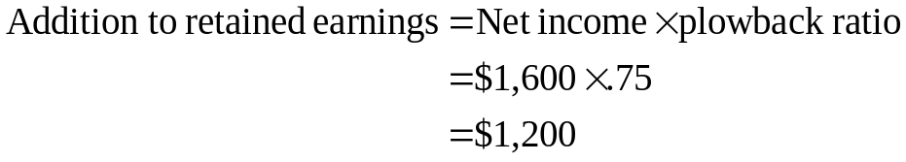
3: Plowback and dividend payout ratios
Your company has net income of $1,600 for the year. You paid out $400 in dividends to your stockholders.

Slide 5
4: Plowback and dividend payout ratios
This year your company expects net income of $2,800. You now adhere to a 60% plowback ratio.
What is the expected dollar increase in retained earnings?
How much do you expect to pay in dividends?
What is the dividend payout ratio?

Slide 6
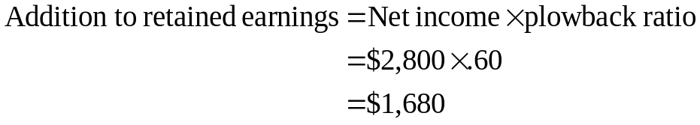
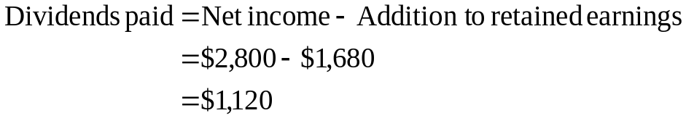
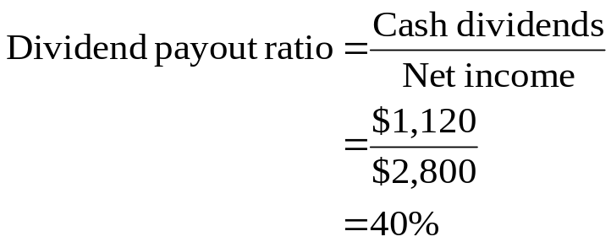
5: Plowback and dividend payout ratios
This year your company expects net income of $2,800. You now adhere to a 60% plowback ratio.

Slide 7
6: Constant growth planning
You expect your sales, costs and assets to grow by 10% next year. You will not pay any dividends. Can you complete the pro forma statement? Round all amounts to whole dollars.
Income Statement
Current Projected
Sales $800 $_______
Costs $700 $_______
Taxable income $100 $_______
Taxes (34%) $ 34 $_______
Net income $ 66 $_______
Balance Sheet
Current Projected Current Projected
Assets $400 $_______ Debt $150 $_______
Equity $250 $_______
Total $400 $_______ Total $400 $_______

Slide 8
7: Constant growth planning
The computations are shown on the next slide.
Income Statement
Current Projected
Sales $800 $880
Costs $700 $770
Taxable income $100 $110
Taxes (34%) $ 34 $ 37
Net income $ 66 $ 73
Balance Sheet
Current Projected Current Projected
Assets $400 $440 Debt $150 $117
Equity $250 $323
Total $400 $440 Total $400 $440

Slide 9
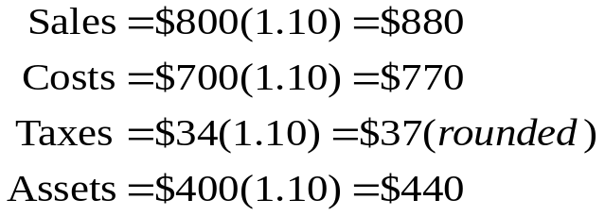
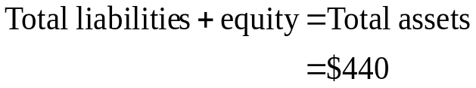
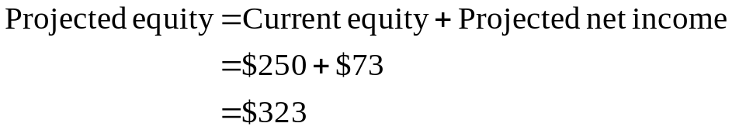
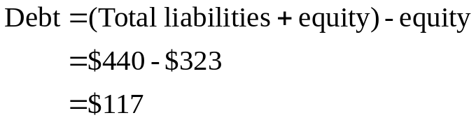
8: Constant growth planning
Step 1
Step 3
Step 2
Step 4

Slide 10
9: Percentage of sales planning
The assets and current liabilities of Jennings, Inc. vary in direct proportion to the increase in sales. The current sales are $2,000 and you expect them to increase by 20% next year. Net income is projected at 5% of sales. The firm is not planning on issuing any more common stock nor paying any dividends.
Using this information, can you compile the pro forma balance sheet shown on the next slide?

Slide 11
10: Percentage of sales planning
Current % of sales Projected
Cash $ 120 _____% $_______
Accounts receivable $ 500 _____% $_______
Inventory $ 840 _____% $_______
Fixed assets $2,600 _____% $_______
Total assets $4,060 _____% $_______
Accounts payable $ 600 _____% $_______
Long-term debt $ 700 _____% $_______
Common stock and paid in surplus $1,000 _____% $_______
Retained earnings $1,760 _____% $_______
Total liabilities and equity $4,060 _____% $_______
Refer to the prior slide for information pertaining to this problem.
Enter n/a where the % of sales does not apply.

Slide 12
11: Percentage of sales planning
Current % of sales Projected
Cash $ 120 6% $ 144
Accounts receivable $ 500 25% $ 600
Inventory $ 840 42% $1,008
Fixed assets $2,600 130% $3,120
Total assets $4,060 203% $4,872
Accounts payable $ 600 30% $ 720
Long-term debt $ 700 n/a $1,272
Common stock and paid in surplus $1,000 n/a $1,000
Retained earnings $1,760 n/a $1,880
Total liabilities and equity $4,060 n/a $4,872
See the next slide for the computations

Slide 13
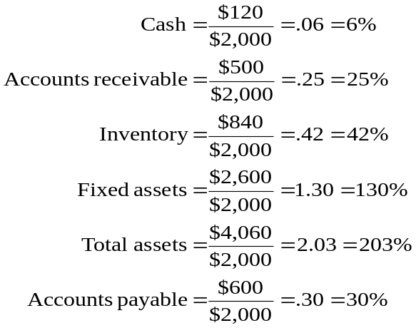
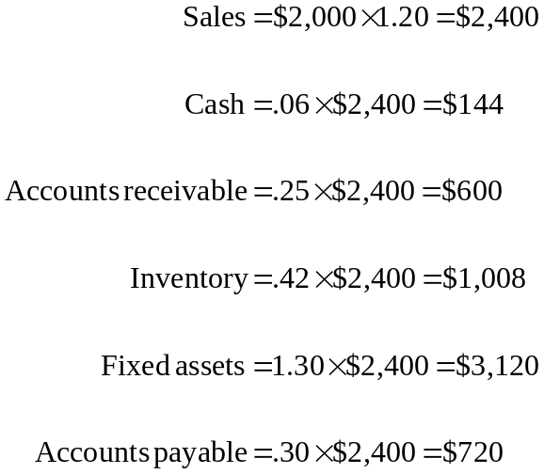
12: Percentage of sales planning
Step 1
Step 2
Computations continued on next slide

Slide 14
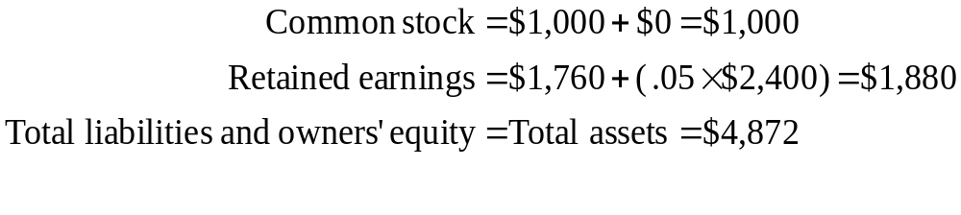
13: Percentage of sales planning
Step 3
Step 4
Total liabilities and owners’ equity $4,872
Accounts payable -$ 720
Common stock and paid in surplus -$1,000
Retained earnings -$1,880
Long-term debt $1,272

Slide 15
14: External financing need
You project your sales will increase by $3,000 next year. Net income is 10% of sales and accounts payable is 25% of sales. The capital intensity ratio is 2.5. No dividends are anticipated.
How much external financing is needed to fund this growth?
Try to solve this problem without looking at the hints on the next slide.

Slide 16
15: External financing need
You project your sales will increase by $3,000 next year. Net income is 10% of sales and accounts payable is 25% of sales. The capital intensity ratio is 2.5. No dividends are anticipated.
How much external financing is needed to fund this growth?
Hints:
Step 1: Compute the increase in total assets
Step 2: Compute the increase in accounts payable
Step 3: Compute the increase in retained earnings
Step 4: Compute the additional long-term debt and equity financing that is needed

Slide 17
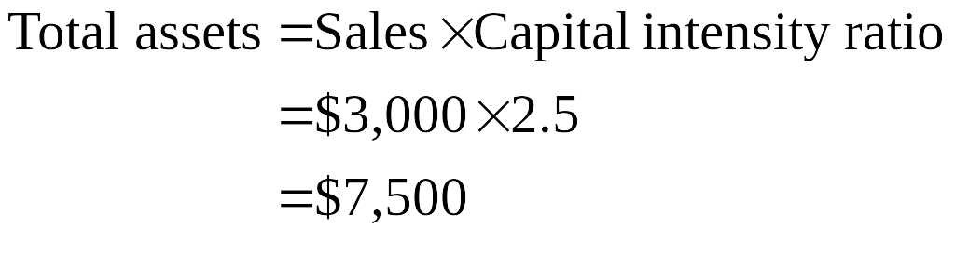
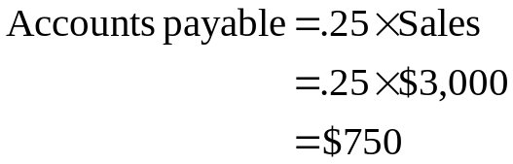
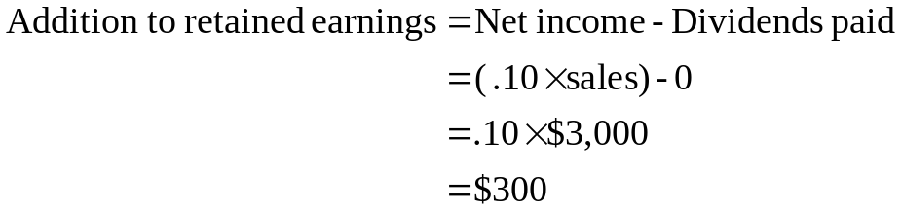
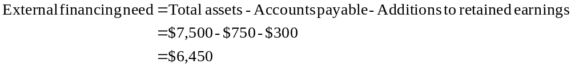
16: External financing need
Step 1
Step 2
Step 3
Step 4

Slide 18
17: Pro forma with external financing
Your firm currently has long-term debt of $4,400, common stock and paid in surplus of $10,000 and retained earnings of $4,600. The capital intensity ratio is 2.2 and the tax rate is 35%. Costs are 72% of sales and accounts payable are 30% of sales. Sales currently are $10,000 and are expected to increase by 10% next year. The dividend payout ratio is 20%. Long-term debt will be used to fund 40% of the external funding need.
Given this information, can you complete the pro forma financial statements on the next slide?

Slide 19
18: Pro forma with external financing
Round all amounts to whole dollars.
Pro forma Income Statement
Sales $______
Costs $______
Taxable income $______
Taxes (35%) $______
Net Income $______
Pro forma Balance Sheet
Assets $______ Accounts payable $______
Long-term debt $______
Common stock $______
Retained earnings $______
Total $______ Total $______

Slide 20
19: Pro forma with external financing
The computations are shown on the next four slides.
Pro forma Income Statement
Sales $11,000
Costs $ 7,920
Taxable income $ 3,080
Taxes (35%) $ 1,078
Net Income $ 2,002
Pro forma Balance Sheet
Assets $24,200 Accounts payable $ 3,300
Long-term debt $ 4,519
Common stock $10,179
_______ Retained earnings $ 6,202
Total $24,200 Total $24,200

Slide 21
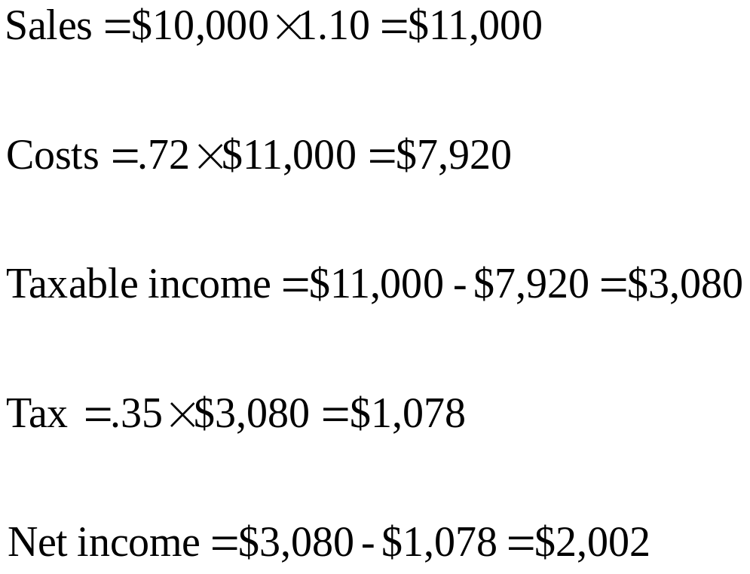
20: Pro forma with external financing

Slide 22
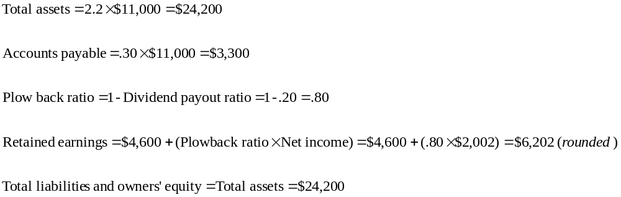
21: Pro forma with external financing

Slide 23
22: Pro forma with external financing
Total liabilities and owners’ equity $24,200
Accounts payable -$ 3,300
Retained earnings -$ 6,202
Current long-term debt -$ 4,400
Current common stock -$10,000
External financing need $ 298

Slide 24
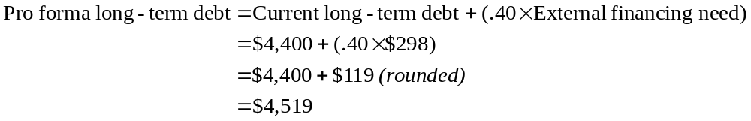
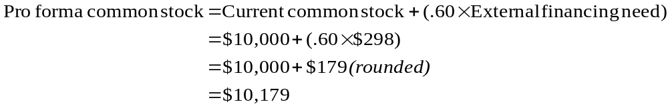
23: Pro forma with external financing

Slide 25
24: Capacity level
Your firm has fixed assets of $28,000 and is operating at 80% of capacity. Current sales are $18,000.
What is the full-capacity sales level?
What is the capital intensity ratio at the full-capacity sales level?

Slide 26
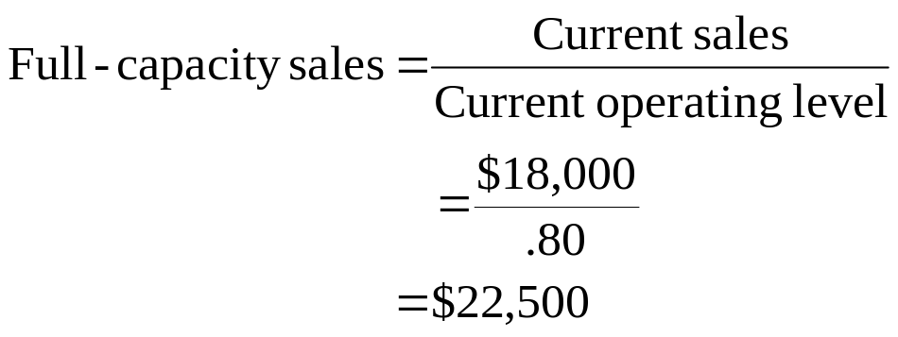
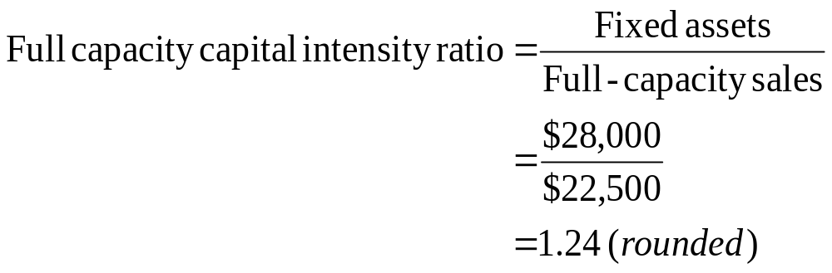
25: Capacity level
Your firm has fixed assets of $28,000 and is operating at 80% of capacity. Current sales are $18,000.

Slide 27
26: Capacity level
Your firm has projected sales of $1,600. The capital intensity ratio at the full-capacity sales level of $1,900 is 1.20. Ignoring the capacity level, you have projected net fixed assets at $2,100 and the external financing need at $1,000.
What is the external financing need if the capacity level is considered?

Slide 28
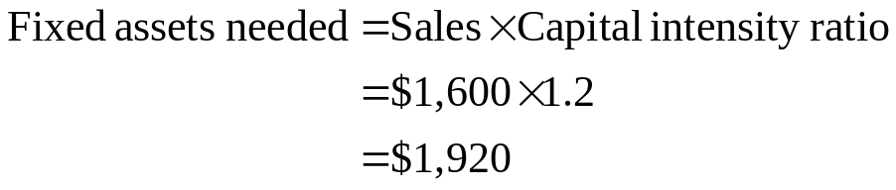
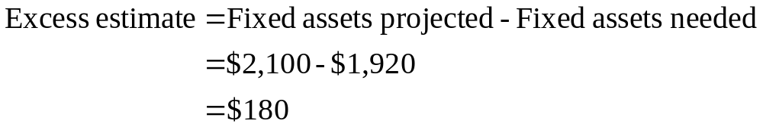

27: Capacity level
Your firm has projected sales of $1,600. The capital intensity ratio at the full-capacity sales level of $1,900 is 1.20. Ignoring the capacity level, you have projected net fixed assets at $2,100 and the external financing need at $1,000. What is the external financing need if the capacity level is considered?

Slide 29
28: Internal growth
Your firm has net income of $6,000 and total assets of $30,000.
The dividend payout ratio is 40%.
What is the internal growth rate?

Slide 30
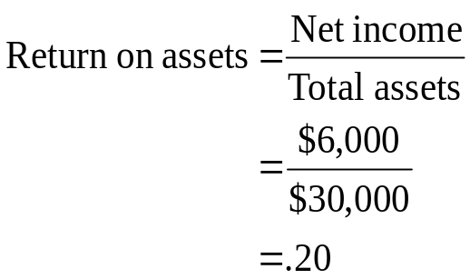

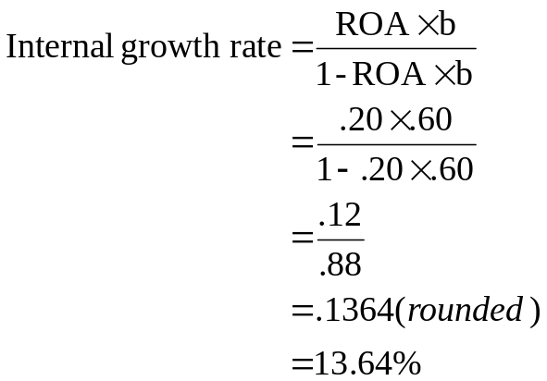
29: Internal growth
Your firm has net income of $6,000 and total assets of $30,000. The dividend payout ratio is 40%. What is the internal growth rate?

Slide 31
30: Sustainable growth
A firm has net income of $2,000 and pays $400 in dividends. Total equity is $8,000.
What is the sustainable growth rate?

Slide 32
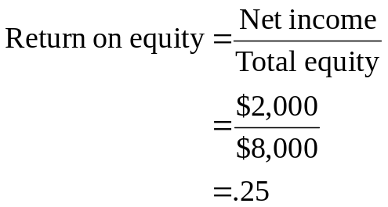

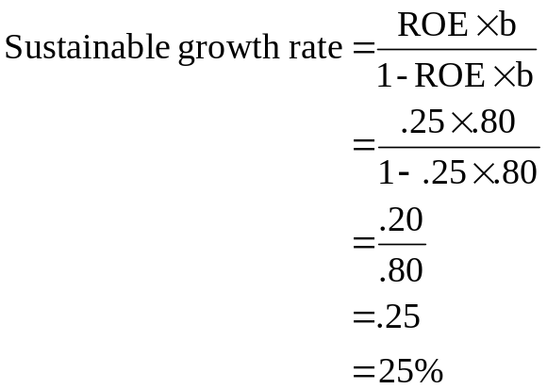

31: Sustainable growth
A firm has net income of $2,000 and pays $400 in dividends. Total equity is $8,000. What is the sustainable growth rate?
Step 3
Step 1
Step 4
Step 2

Slide 33
32: Sustainable growth
Your firm has a 10% net profit margin and a dividend payout ratio of 25%. The debt-equity ratio is 40% and the total asset turnover rate is 2.
What is the sustainable rate of growth?

Slide 34
33: Sustainable growth
Your firm has a 10% net profit margin and a dividend payout ratio of 25%. The debt-equity ratio is 40% and the total asset turnover rate is 2. What is the sustainable rate of growth?
Hints:
Step 1. Find the equity multiplier using the debt-equity ratio
Step 2. Compute the ROE using the DuPont formula
Step 3. Find the plowback ratio using the dividend payout ratio
Step 4. Compute the sustainable growth rate

Slide 35
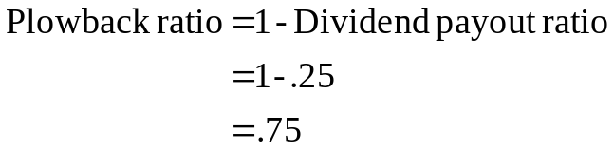
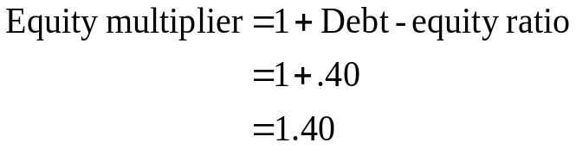
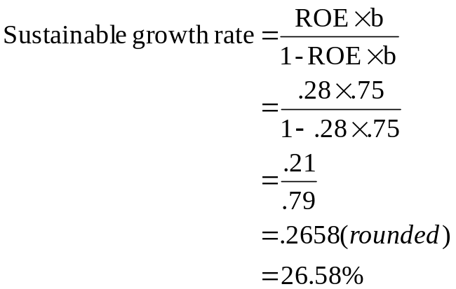
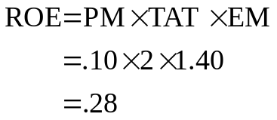
34: Sustainable growth
Your firm has a 10% net profit margin and a dividend payout ratio of 25%. The debt-equity ratio is 40% and the total asset turnover rate is 2.
Step 3
Step 1
Step 4
Step 2

Slide 36
4
End of Chapter 4

